Slide 1
ECE 884 Deep Learning
Lecture 6: Loss Function
02/04/2021

Slide 2
Logistics
Google sheet
Please form your groups ASAP
02/11/2021: Presentations of the Project Ideas
Each group has 10mins presentation + 3mins Q&A
Please prepare your presentation slides with the following items
What topic you aim to work on?
What are the existing works?
How your idea is different from existing ones?
What are the expected results?
What is the impact?

Slide 3
Review of last lecture
Function form#2: parametric linear models
Function form#3: parametric nonlinear models (DL models)
Understand why deep learning models are powerful and importance of massive computation and large data sets.

Slide 4
Today’s lecture
Loss Function
What it is, what is it for?
Example: cross-entropy loss function
Regularization
What it is, what is it for?
Examples

Slide 5
Recall: Task#1: function form
y = f(x)
Task#1: function form
output
prediction function
input
Formulation:
Given training data: {(x₁,y₁), …, (x_{N},y_{N})},
Find y = f(x) ∈ " using training data
• such that f is correct on test data
Credit: Lazebnik, Liang

Slide 6
Score Function
Decision Regions
(Linear) Score Function
Airplane
Score
f(x,W) = Wx + b
Car Score
Cat Score
Classifier score
Given a W (and b), we can compute a score for each class given an input x.
Value of pixel (15, 8, 0)
Credit: Justin

Slide 7
Score Function
Decision Regions
(Linear) Score Function
Airplane
Score
f(x,W) = Wx + b
Car Score
Cat Score
Good classifier: output a high score for the correct class, and a low score for the wrong class.
Classifier score
Value of pixel (15, 8, 0)
Credit: Justin

Slide 8
Loss Function
What is loss function: a loss function is a function that measures how good our classifier is.
Low loss = good classifier
High loss = bad classifier
Credit: Justin

Slide 9
Loss Function
Input
Output
Function form

Slide 10
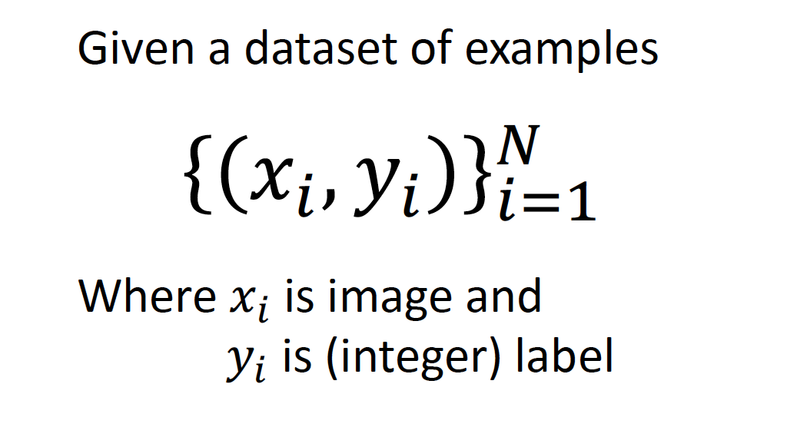
Loss Function
Input of the loss function

Slide 11

Loss Function
Output: Loss for a single data { xi, yi }

Slide 12
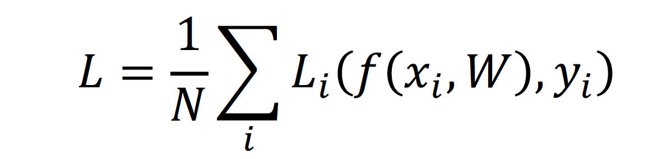
Loss Function
Output: Loss for a single data
Output: Loss for the whole training data set with N data samples

Slide 13
Loss Function has different forms

Slide 14
Loss Function has different forms
Different problems have different loss functions
CV
NLP
Speech

Slide 15
Cross-Entropy Loss Function
One of the most commonly used ones in deep learning
Nice property: interpret as probabilities

Slide 16

Input: Xi
Stretch pixels into column
56
231
24
2
56 | 231
24 | 2
Input image Xi
Xi
Credit: Justin

Slide 17
Output: Yi
One-hot encoding
56 | 231
24 | 2
1
0
0
Yi
True Label

Slide 18
Input -> Score Function
Stretch pixels into column
raw classifier
scores (logits)
56
231
24
2
0.2 | -0.5 | 0.1 | 2.0
1.5 | 1.3 | 2.1 | 0.0
0 | 0.25 | 0.2 | -0.3
1.1
3.2
-1.2
3.2
5.1
-1.7
56 | 231
24 | 2
+ =
Input image Xi
W (3, 4)
b
(3,)
(3,)
Xi
Credit: Justin

Slide 19
Measure how good the classifier by comparing:
raw classifier
scores (logits)
One-hot encoding
3.2
5.1
-1.7
1
0
0
True Label

Slide 20
Measure how good the classifier by comparing:
raw classifier
scores (logits)
One-hot encoding
3.2
5.1
-1.7
1
0
0
This is Not probability
This is probability
True Label

Slide 21
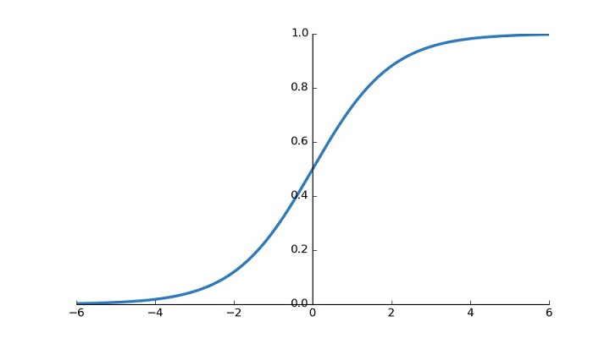
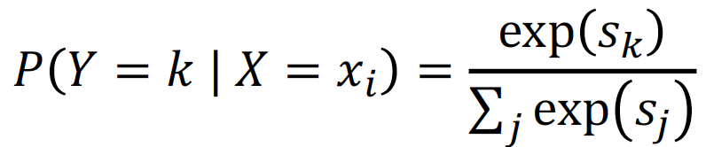
Softmax Transformation
logits

Slide 22
Softmax Transformation
raw classifier
scores (logits)
3.2
5.1
-1.7
0.12
0.87
0.01
softmax
This is Not probability
This is probability

Slide 23
Cross-Entropy: Measure the distance between 2 probability vectors
Softmax
One-hot encoding
0.12
0.87
0.01
1
0
0
Cross Entropy
True Label

Slide 24

Cross-Entropy: Measure the distance between 2 probability vectors
Softmax
One-hot encoding
q
p
0.12
0.87
0.01
1
0
0
Cross Entropy
True Label

Slide 25
Cross-Entropy: Measure the distance between 2 probability vectors
Softmax
One-hot encoding
q
p
0.12
0.87
0.01
1
0
0
Cross Entropy
It is not symmetric
True Label

Slide 26
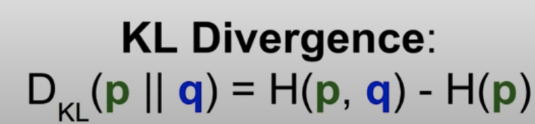
Cross-Entropy: Measure the distance between 2 probability vectors
Softmax
One-hot encoding
q
p
0.12
0.87
0.01
1
0
0
True Label

Slide 27

Cross-Entropy: Measure the distance between 2 probability vectors
Softmax
One-hot encoding
q
p
0.12
0.87
0.01
1
0
0
Cross Entropy
Only with one-hot
True Label

Slide 28
Cross-Entropy: Measure the distance between 2 probability vectors
Softmax
One-hot encoding
q
p
0.12
0.87
0.01
1
0
0
Q: What is the min /max possible loss L_{i}?
Cross Entropy
Only with one-hot
True Label
Credit: Justin

Slide 29
Cross-Entropy: Measure the distance between 2 probability vectors
Softmax
One-hot encoding
q
p
0.12
0.87
0.01
1
0
0
Q: What is the min /max possible loss L_{i}?
Cross Entropy
A: Min 0,
max +infinity
Only with one-hot
True Label
Credit: Justin

Slide 30
Cross-Entropy: Measure the distance between 2 probability vectors
Softmax
One-hot encoding
q
p
0.12
0.87
0.01
1
0
0
Q: If all scores are small random values, what is the loss?
Cross Entropy
Only with one-hot
True Label

Slide 31
Cross-Entropy: Measure the distance between 2 probability vectors
Softmax
One-hot encoding
q
p
0.12
0.87
0.01
1
0
0
Q: If all scores are small random values, what is the loss?
Cross Entropy
A: -log(1/C) log(10) ≈ 2.3
Only with one-hot
True Label
Credit: Justin

Slide 32
Summary
raw classifier
scores (logits)
Softmax
One-hot encoding
Xi
q
p
Q: If all scores are small random values, what is the loss?
56
231
24
2
3.2
5.1
-1.7
0.12
0.87
0.01
1
0
0
Score
Function
Softmax
Function
Cross Entropy
A: -log(1/C) log(10) ≈ 2.3
True Label Yi

Slide 33
Problem of Loss Function
Loss functions encourage good performance on training data but we really care about test data
Credit: Justin

Slide 34
Overfitting
A model is overfit when it performs too well on the training data, but has poor performance for unseen data
Credit: Justin

Slide 35
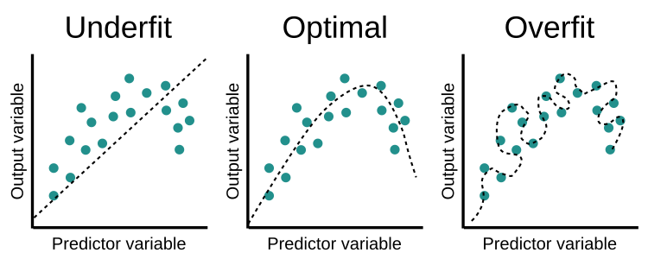
Overfitting
A model is overfit when it performs too well on the training data, but has poor performance for unseen data

Slide 36
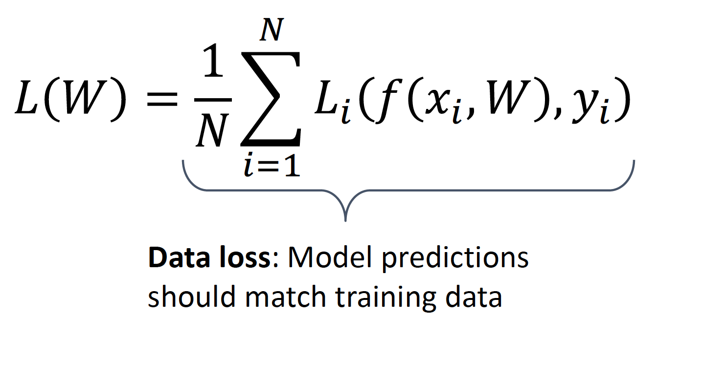
Regularization: Beyond Training Error
Credit: Justin

Slide 37
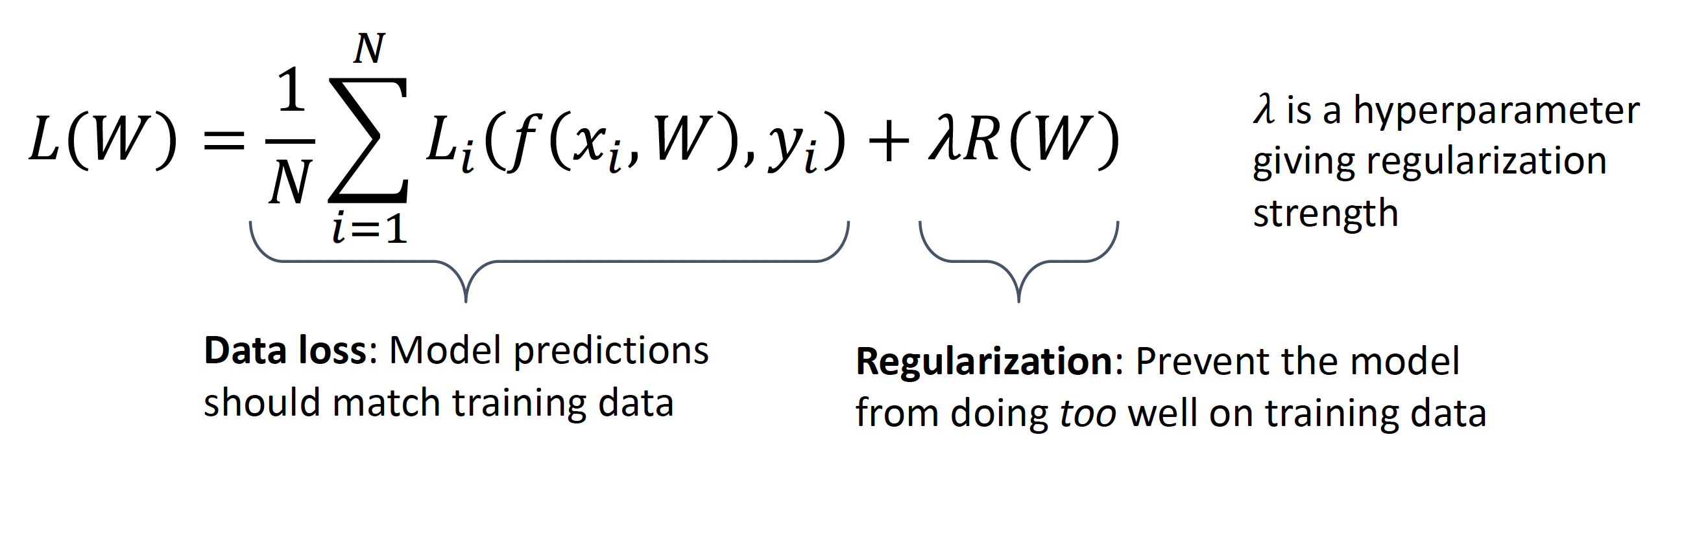
Regularization: Beyond Training Error
Credit: Justin

Slide 38
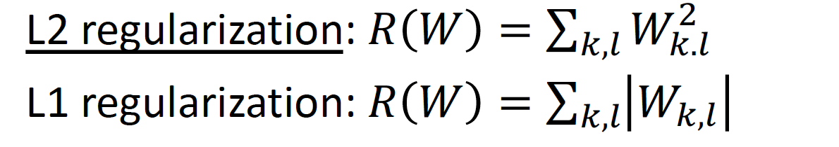
Example Regularization
Credit: Justin

Slide 39
Effect of Regularization
Select simpler model with lower order

Slide 40
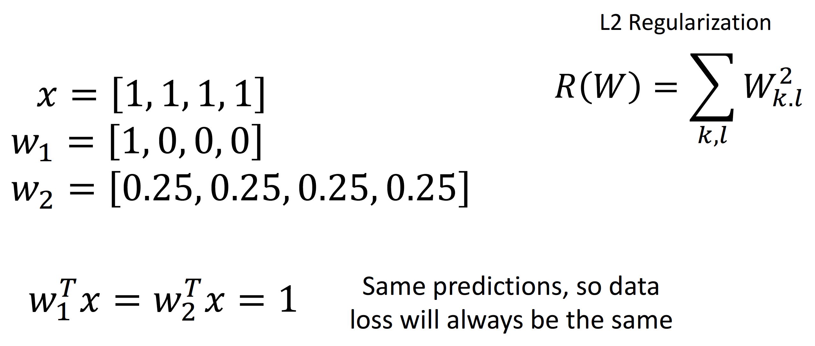
Effect of Regularization
Select model with more features
Credit: Justin

Slide 41
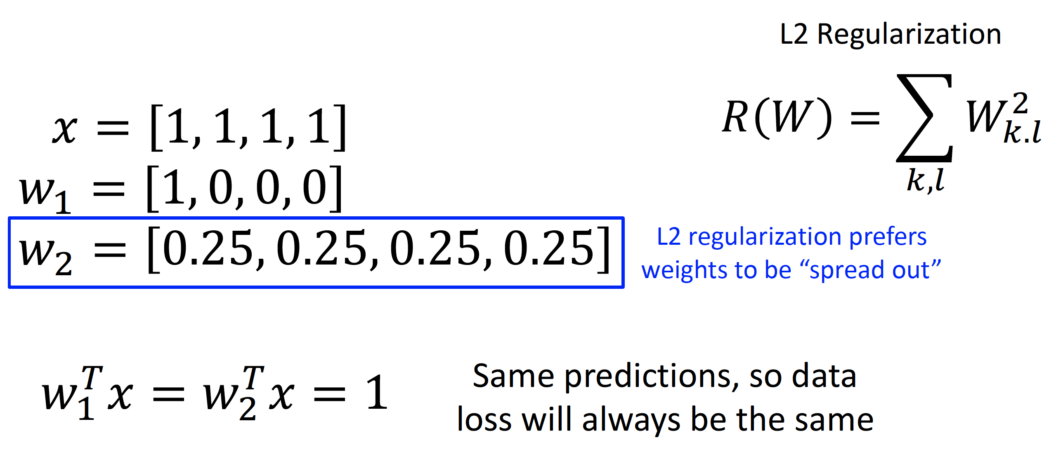
Effect of Regularization
Select model with more features
Credit: Justin

Slide 42
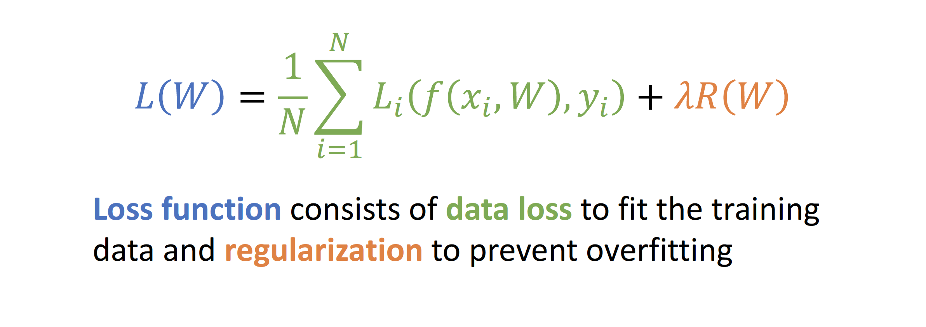
Summary
Credit: Justin

Slide 43
Any Question ?

